Slide 1
ICS – Project Management
Product Requirements
Scope Document

Slide 2
Software Development Models
Traditional Waterfall Model
Requirements
Design
Implement
Test
Deploy / Maintain

Slide 3
Requirements Gathering
Customer needs must drive the design of any product. If it does not satisfy a need, it will not be used.
Despite the detailed requirement gathering, many products miss their target.
Why?
Requirements are often misunderstood or simply ignored as product is developed.

Slide 4
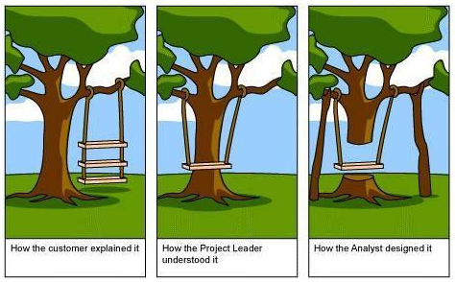
Requirements Gathering

Slide 5
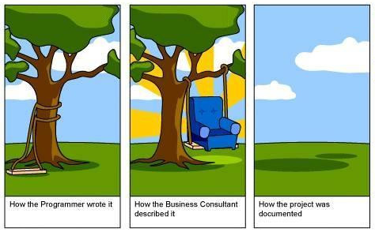
Requirements Gathering

Slide 6
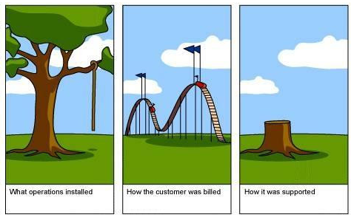
Requirements Gathering

Slide 7
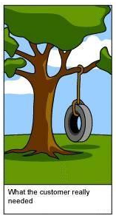
Requirements Gathering

Slide 8
Scope Document
Once product requirements are gathered, a project scope document is created to ensure that all stake holders understand what will be accomplished in the project.
Unexpected change in a project scope are one of the most costly errors that can occur.
You will produce a scope document for a school event. Can you determine *all* the requirements to organize such an event??

